Slide 1

Frontend Development HTML Session – 1 (Cont.)

Slide 2
Understanding Lists: Organising Your Content
Lists are fundamental for presenting information in an organised and readable manner on the web. HTML provides two primary types of lists: unordered and ordered, alongside the flexibility to create nested structures for more complex data.
Unordered Lists (<ul>)
Ordered Lists (<ol>)
Unordered lists are used for grouping items where the order doesn't matter. By default, they are rendered with bullet points. They are perfect for listing features, ingredients, or any collection of items that don't need a specific sequence.
Ordered lists are for items where the sequence is important, such as step-by-step instructions or rankings. These lists are typically rendered with numbers, but can also use letters or Roman numerals.
Preheat oven
Apples
Mix ingredients
Oranges
Bake for 30 minutes
Bananas

Slide 3

Nested Lists: Adding Structure and Hierarchy
Nested lists allow you to create sub-lists within existing list items, providing a way to represent hierarchical relationships in your content. This is incredibly useful for outlines, menus, or categorised information.
Main Category 1
Main Category 2
Example: A Recipe
Sub-item A
Sub-item C
Prepare ingredients
Sub-item B
Sub-item D
Flour
Sugar
Eggs
Follow steps
Mix dry ingredients
Add wet ingredients
Using nested lists makes complex information digestible and improves the overall readability of your web page. It visually guides the user through related pieces of content.

Slide 4


The DOM Tree: Understanding Web Page Structure
The Document Object Model (DOM) is a programming interface for web documents. It represents the page so that programs can change the document structure, style, and content. When a web page is loaded, the browser creates a DOM tree, which is a hierarchical representation of the page's elements.
1
HTML
2
HEAD & BODY
3
H1, P, IMG
Task: make a dom tree for this code:…………………………….
html├── head└── body ├── h1 ├── p └── img

Slide 5

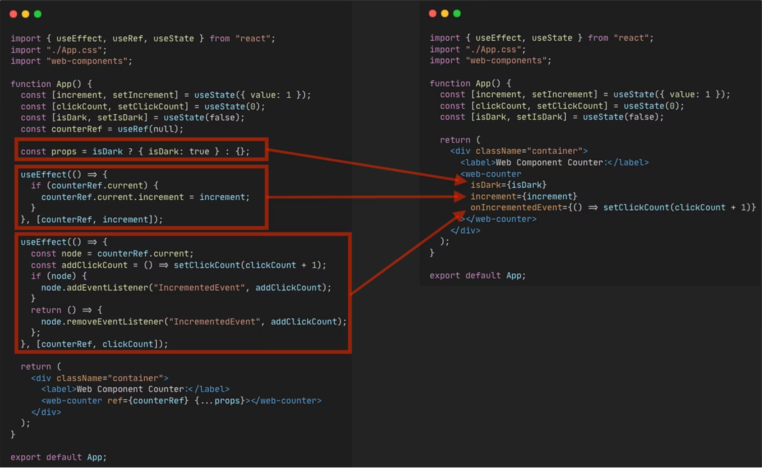
Essential HTML Attributes
Attributes provide additional information about HTML elements, modifying their behaviour or appearance. They are always specified in the start tag and usually come in name/value pairs, like name="value". Mastering these core attributes is crucial for effective web development.
id
Unique identifier for an element.
class
Applies styles to multiple elements.
src
Source for images, media.
href
Destination for links.
alt
Alternate text for images (accessibility).
Boolean Attributes
Attributes that are either present or not, e.g., <button disabled>.
Understanding these attributes allows you to control how elements are displayed, how they interact, and how they contribute to accessibility and functionality.

Slide 6
Introduction to HTML Forms
Forms are a critical component of interactive web pages, allowing users to input data, make selections, and submit information. While we'll dive deep into forms in a later session, it's important to grasp the basics now.
The <form> tag acts as a container for all input elements. Inside, you'll find various input types, labels, and buttons that facilitate user interaction. For instance, a basic form might ask for a user's name and include a submit button.
Input Fields
Submit Button
e.g., <input type="text"> for names.
e.g., <input type="submit"> to send data.

Slide 7
In-Class Tasks: Applying Your HTML Knowledge
Now it's time to put what you've learned into practice! These tasks are designed to reinforce your understanding of HTML fundamentals through hands-on coding. Work through each one, paying attention to the specific requirements.
01
02
Task 1: Basic Page Structure
Task 2: Listing Your Skills
Create a simple HTML page containing an <h1> heading, a <p> paragraph, and an <img> image tag.
Develop a list of your top 5 skills. Experiment with both unordered (<ul>) and ordered (<ol>) lists.
03
04
Task 3: Mastering Links
Task 4: Text Formatting
Create three distinct links: one external (to another website), one internal (to another page in your project), and one anchor link (to a specific section within the current page).
Within a single paragraph, use the <em> (italics), <strong> (bold), and <u> (underline) tags.
These tasks are designed to build your confidence and proficiency with basic HTML elements. Don't hesitate to refer back to your notes or ask questions if you get stuck!

Slide 8
Final Task: Building Your Personal Mini Portfolio
For homework, you'll embark on a bigger, more integrated task: building a personal mini portfolio webpage. This project will consolidate everything you've learned so far about HTML structuring and content presentation. Remember, no CSS yet—focus solely on the HTML structure and content!
Key Sections
Content Requirements
Technical Details
A clear title and subtitle
A list of your skills (using <ul> or <ol>)
Utilise <h1>, <p>, <img>, <a>, <ul>/<ol>, <strong>, <span>
An "About" section with personal details
Social media links (using <a>)
Add comments within your HTML code for clarity
An image of yourself or a relevant graphic
A contact section
Ensure clean and logical structure for DOM readability
This portfolio will serve as your first tangible web project, showcasing your foundational HTML skills. Pay attention to semantic HTML and good coding practices.

Slide 9
Session Summary: Key Learnings
This session has equipped you with a deeper understanding of HTML, moving beyond basic tags to more structured and semantic content creation. You've covered crucial concepts that form the backbone of any well-built web page.
What HTML Is
Webpage Structure
The standard markup language for creating web pages.
How elements are organised in a document.
Basic Tags
Block vs. Inline
Essential elements like headings, paragraphs, and images.
Understanding element display behaviour.
Lists, Links, Images
The DOM Tree
Organising content, navigation, and visual media.
Hierarchical representation of your web page.
Core Attributes
Practical Tasks
Modifying element behaviour and appearance.
Hands-on application of learned concepts.
You've taken significant steps in building your frontend development skills. Keep practising, and you'll soon be crafting sophisticated web experiences!

Slide 10

Thank You!
Any Questions?

